Slide 1
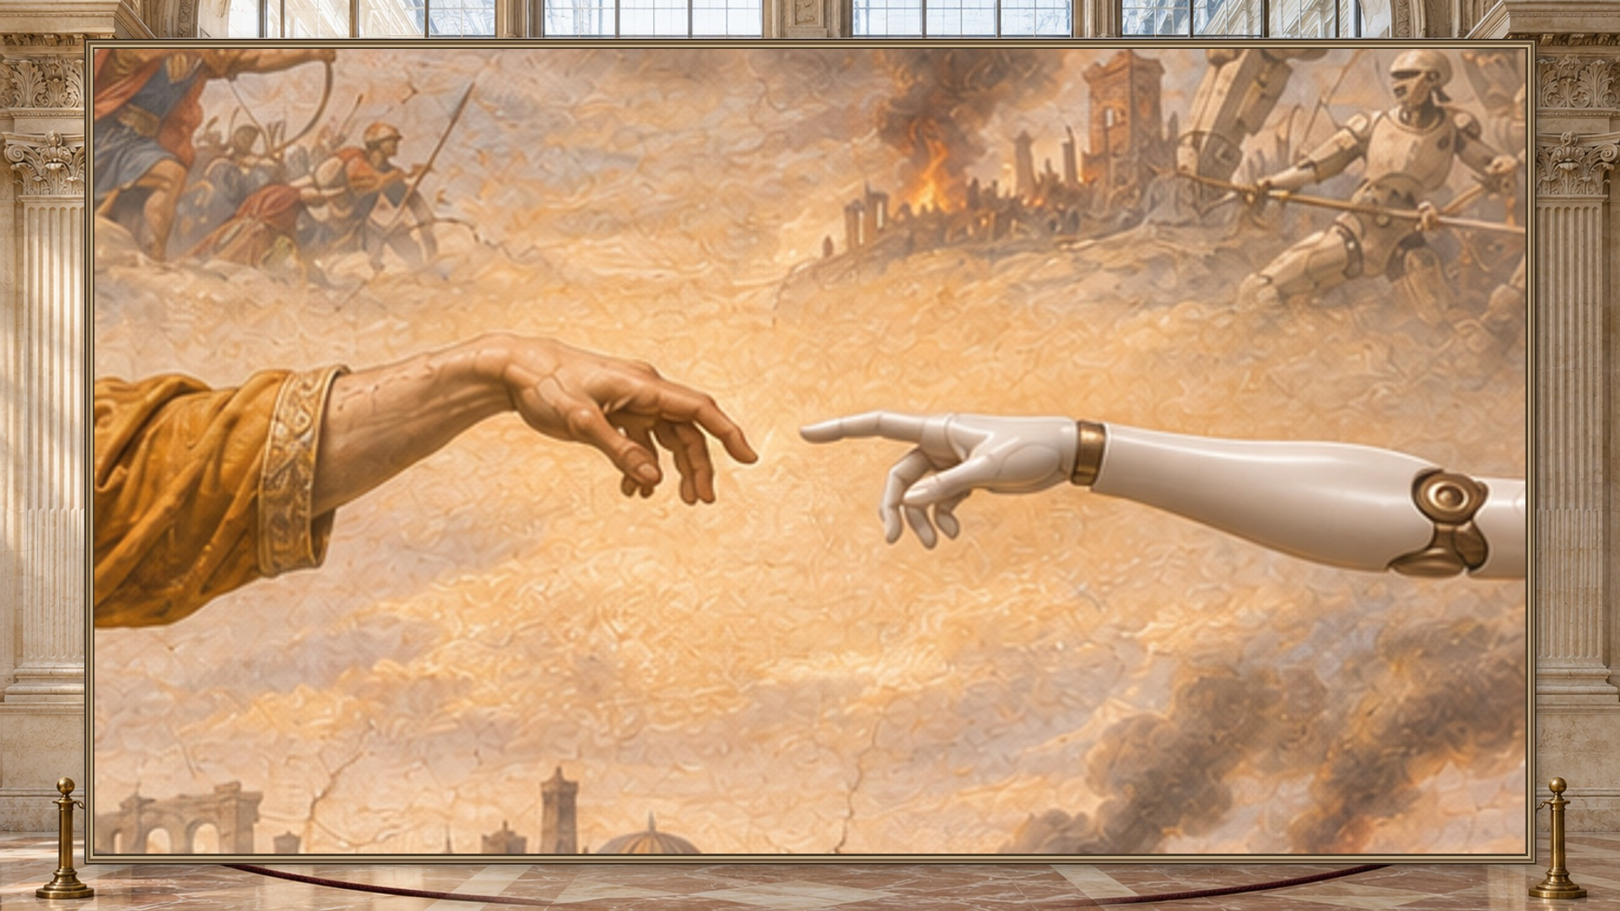
Notes:
Open in silence on the fingertip detail. Play the pullback. Let the painted conflict come into view, then ask: “How can we avoid this future?” Give the room a beat. The fresco is a concept image.

Slide 2
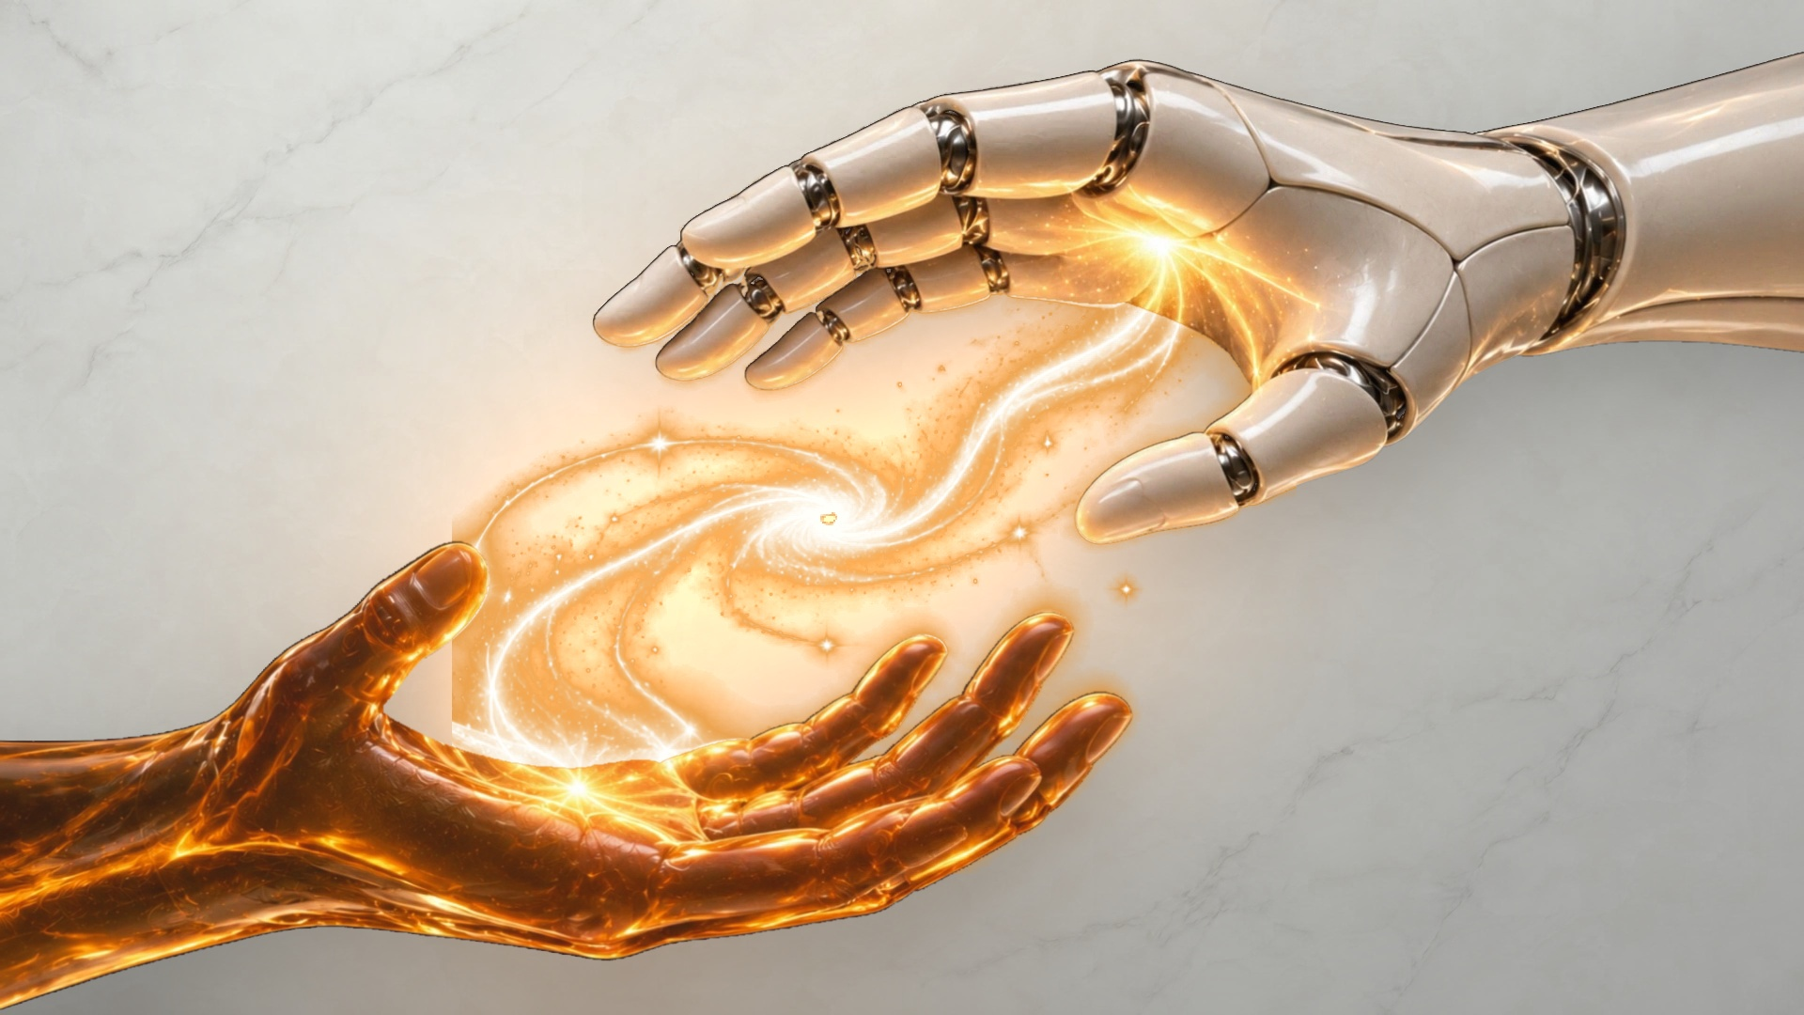

Slide 3
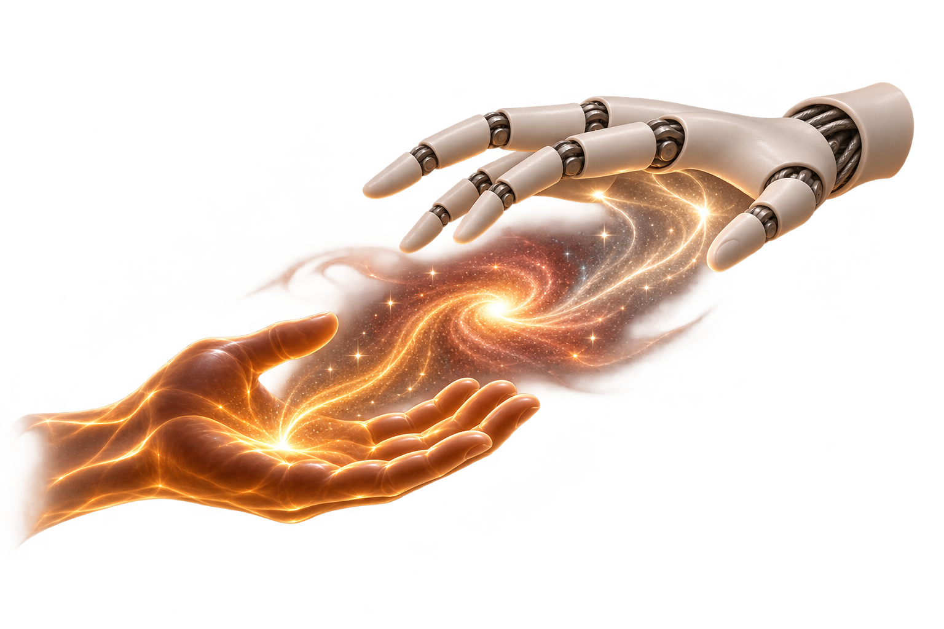
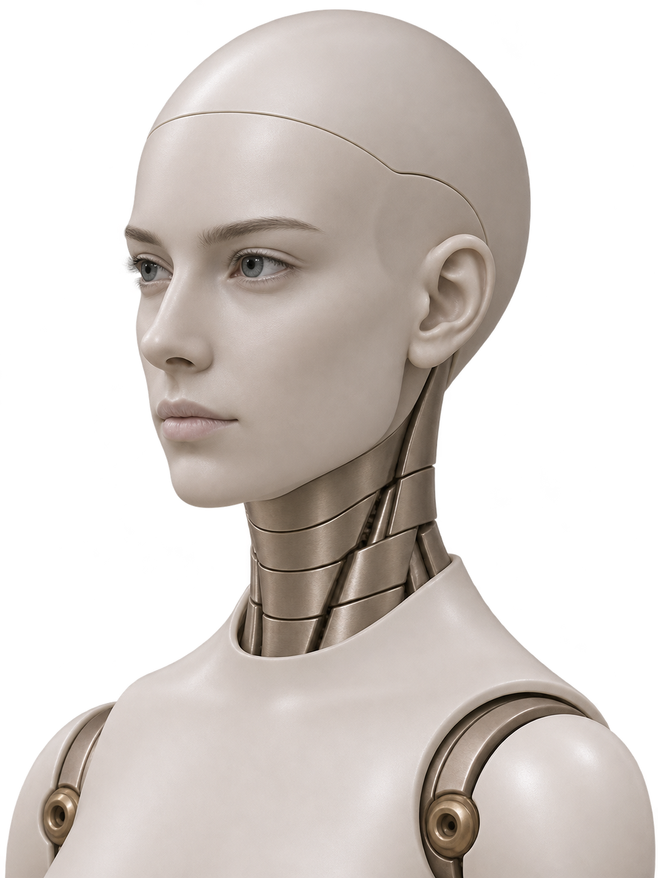
The Human
Touch
Human–robot interaction in simulation
Notes:
Our answer starts with an ordinary request. We call the platform The Human Touch. Real people can rehearse interactions with virtual robots from wherever they are.

Slide 4
“Hold my beer.”
The Human Touch
Notes:
Turn to the physical station. Say “Hold my beer.” Use the feature-locked version: place the empty can on the taped mark unless a handoff is verified. Let the arm finish. Say “Thanks.” If the live take stalls, play the real station backup captured after freeze. At rehearsal, speak the cue and advance. Do not present the museum films as hardware footage.

Slide 5
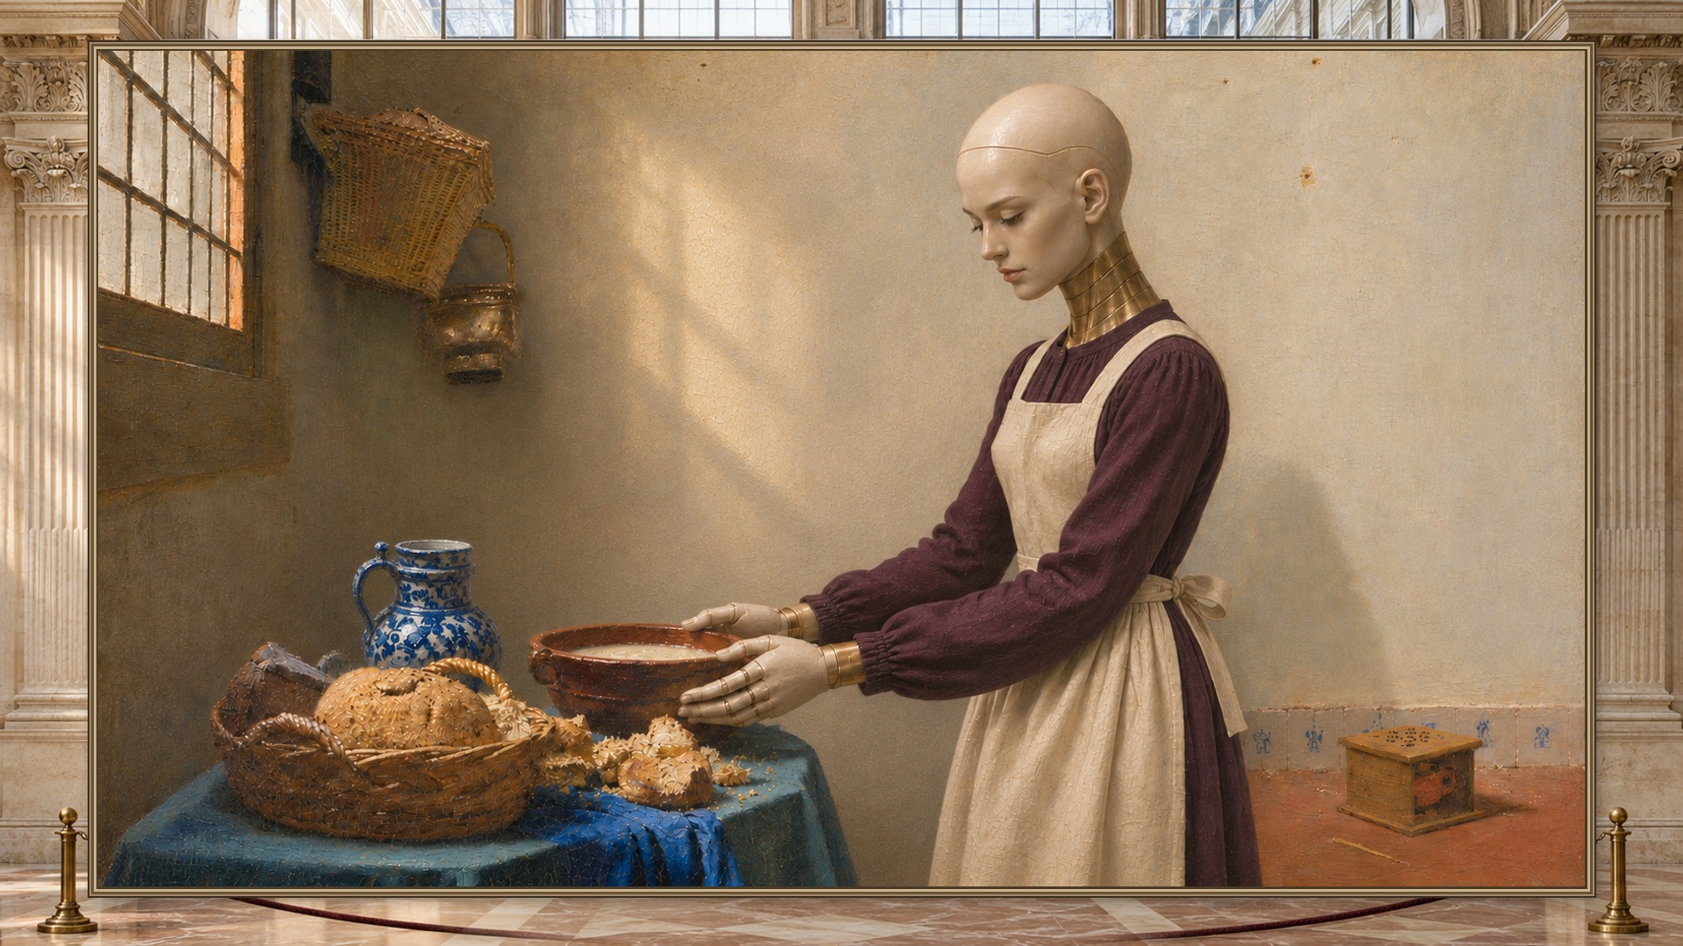
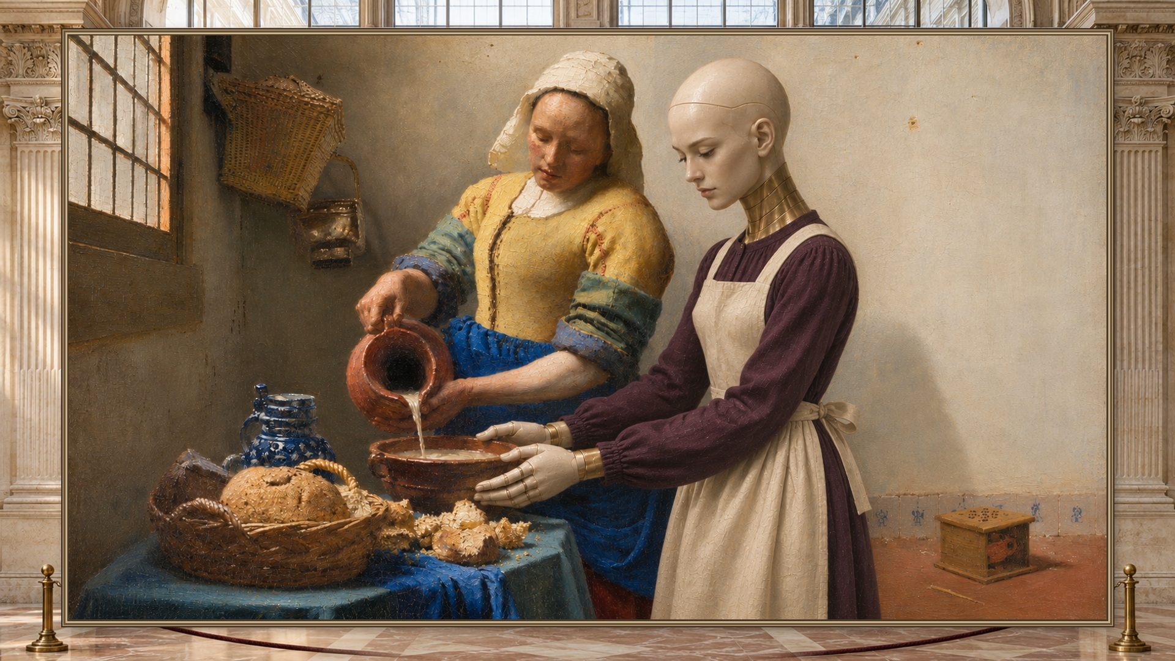
Who gives the cue?
Rehearsing alone
Rehearsing with a person
Notes:
A robot can practice a trajectory in an empty room. A person changes the task: where to offer a loaf, when to steady a bowl, and when to wait. We want robot makers to be able to rehearse those cues with real people. The artworks illustrate the idea.

Slide 6
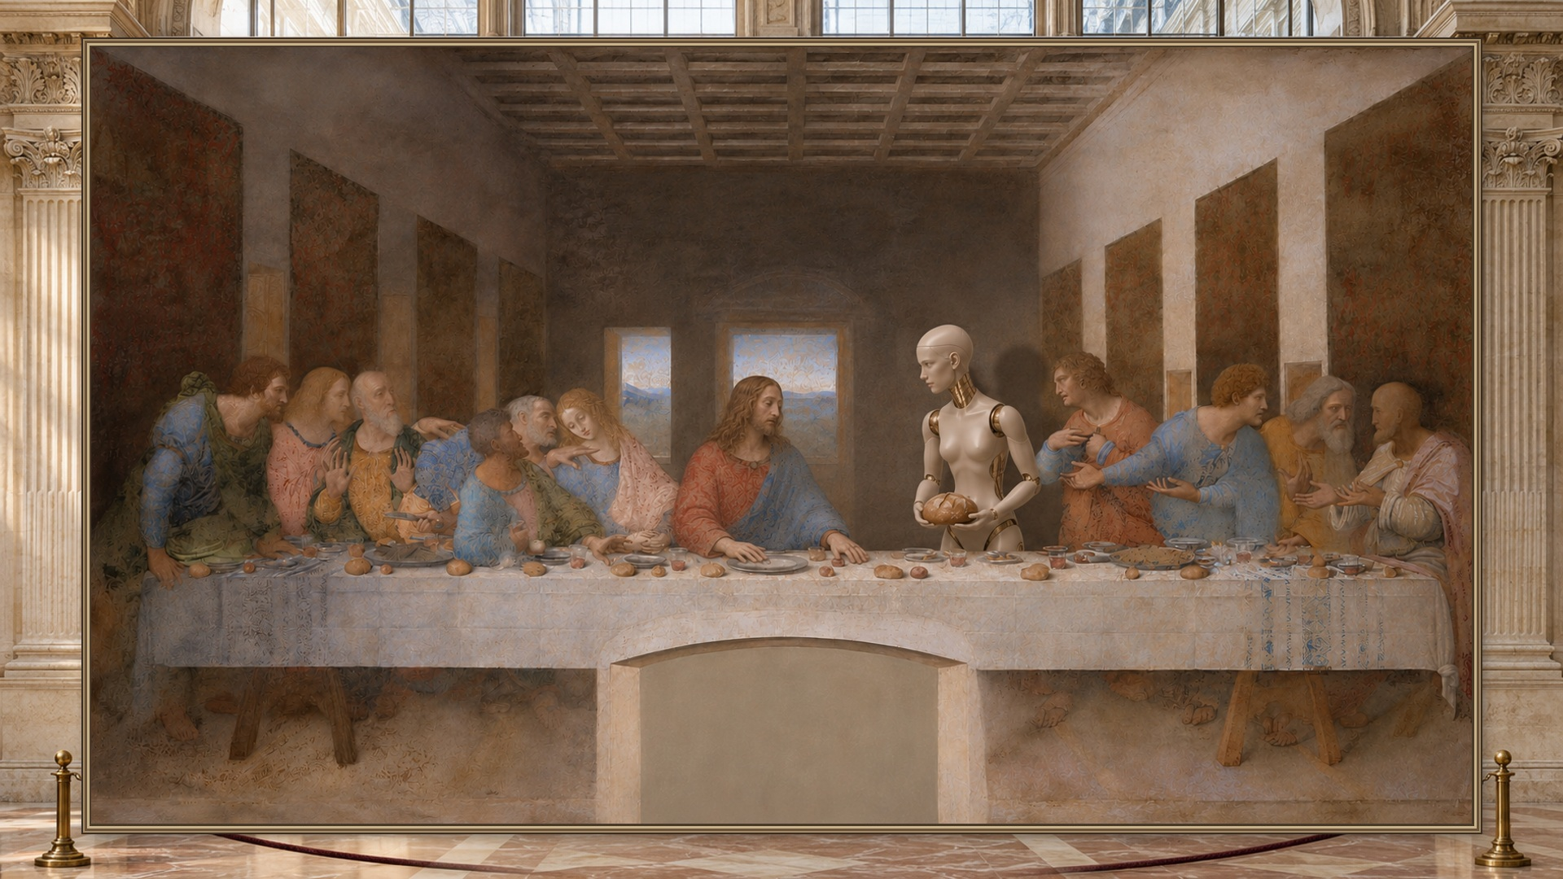
Notes:
Jesus reaches first. Emmy offers the loaf and waits. A change in a person’s timing changes what counts as helpful. Play the short clip, then advance.

Slide 7
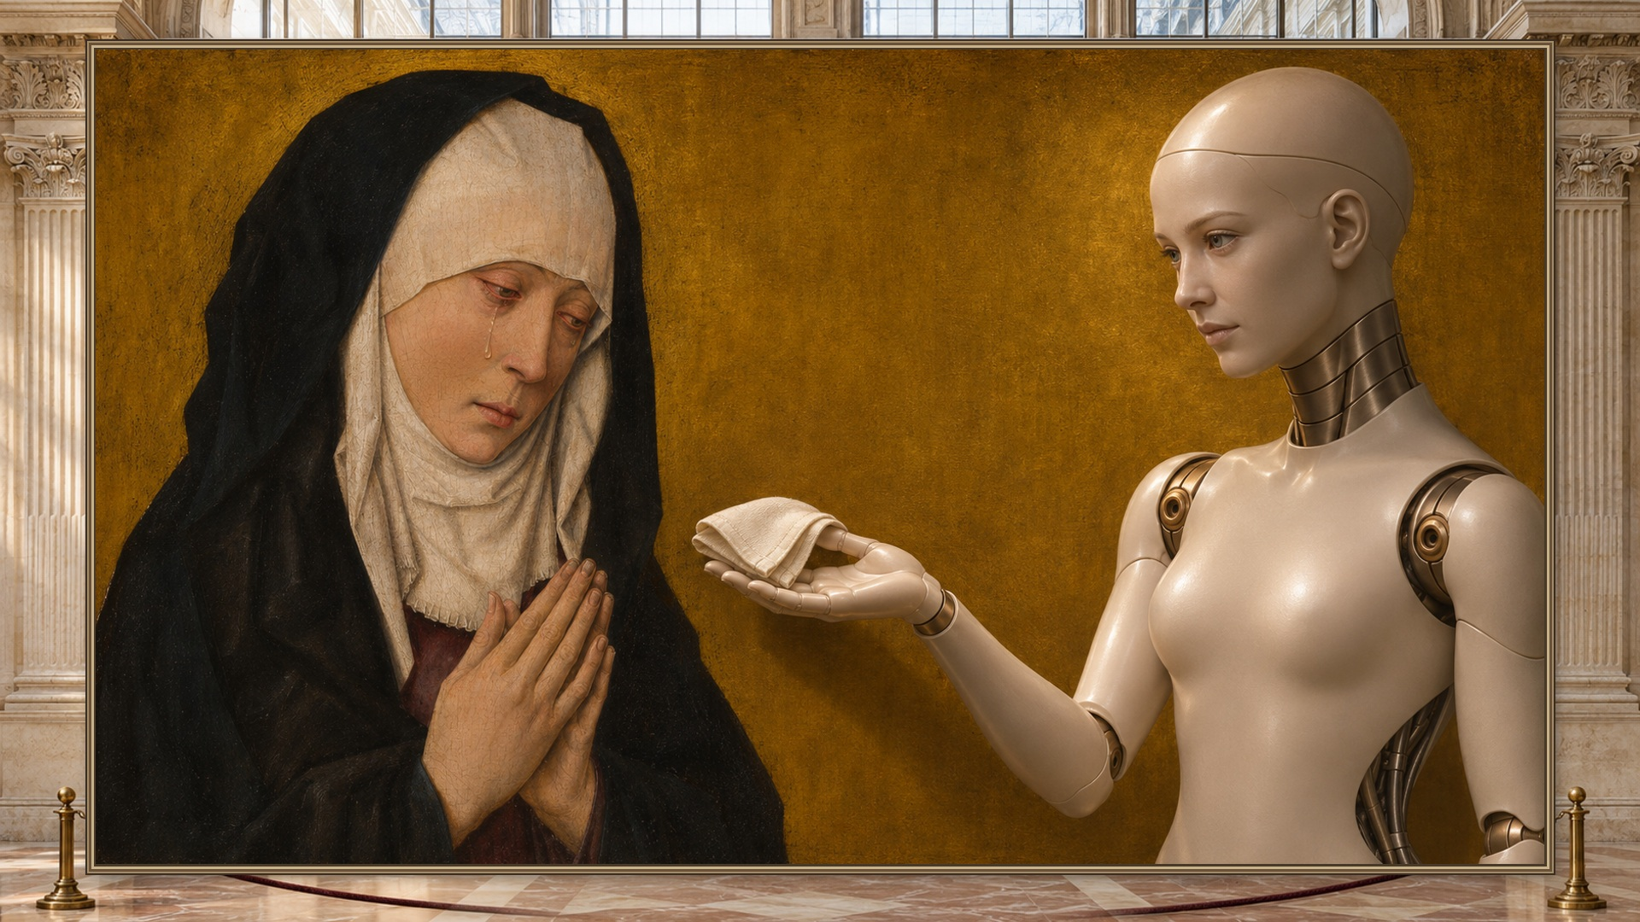
Notes:
The painted woman lowers her gaze. Emmy offers the kerchief and lets the woman choose whether to take it. Play the short clip, then advance.

Slide 8
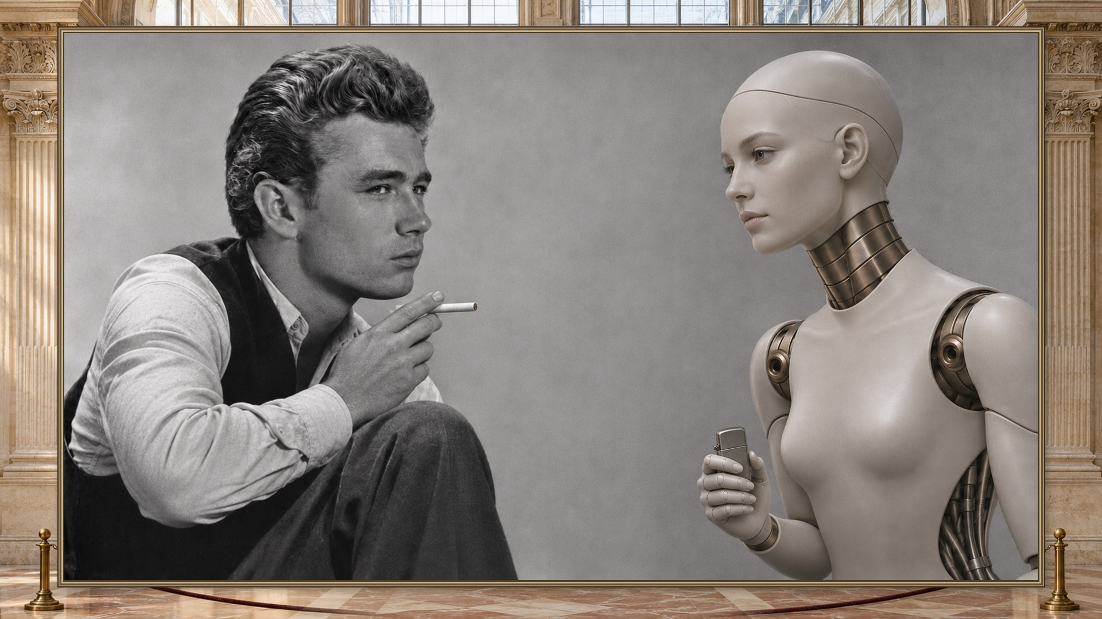
Notes:
Dean raises the cigarette first. Emmy notices and offers a light. Different era, same need to read the person. Play the short clip, then advance.

Slide 9
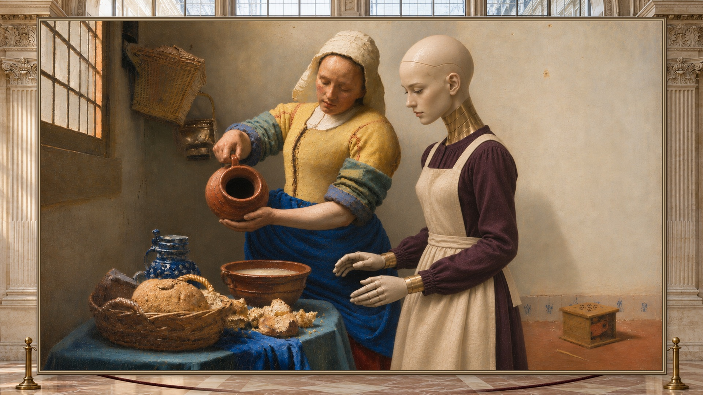
Notes:
The milkmaid tips the jug. Emmy steadies the bowl. One robot can rehearse different cues with different people. Play the short clip, then advance.

Slide 10
One person can enter a virtual rehearsal.
Webcam / Quest
Unreal + Isaac
A real participant
Shared scene and physics-based rehearsal
Dream → simulated robots
Codex → physical robot
Notes:
A participant can join through a webcam or Quest. Unreal brings the person and virtual robot into one shared scene. Isaac is the physics-based rehearsal part of the system design. Dream supplied actions for simulated arms. The physical right-arm run used a separate SDK control path. Live Isaac streaming and sim-to-real transfer are future integration work. For finals, show the matched webcam/avatar and Quest footage if captured.

Slide 11
10
84
Dream attempts in 170 seconds
parallel simulations
16 s
Right arm: pick, lift, place, park
Notes:
Ten simulations ran in parallel. Across a measured run Dream made 84 attempts in 170 seconds. An attempt is a request, not a successful pick. Separately the physical right Maker Arm picked up a cylinder, lifted it, placed it and parked in 16 seconds using replayed waypoints. These are separate observations, not a transfer result.

Slide 12
A grasp can still slip.
Cup-hold rehearsal
Notes:
A fleet can repeat a miss as easily as a successful pick. A simulated cup could slip during the hold. Show one real missed grab after cameras roll, if the team has the clip. An earlier block pickup or cylinder lift cannot stand in for a verified stable cup hold.

Slide 13
What comes
next
Assist intent
Invite more people
Test transfer
Notes:
Next we want to infer intent and smooth a person’s control input, bring more remote people into parallel rehearsals, then test whether a skill learned in simulation transfers to the real arm. These are three next experiments.

Slide 14

Bring a human
into rehearsal.
Explore the project
Notes:
Invite robot builders and remote participants to explore the project. Bring one gesture worth rehearsing. The QR code opens the public project repository. Hold the final card.

Slide 15
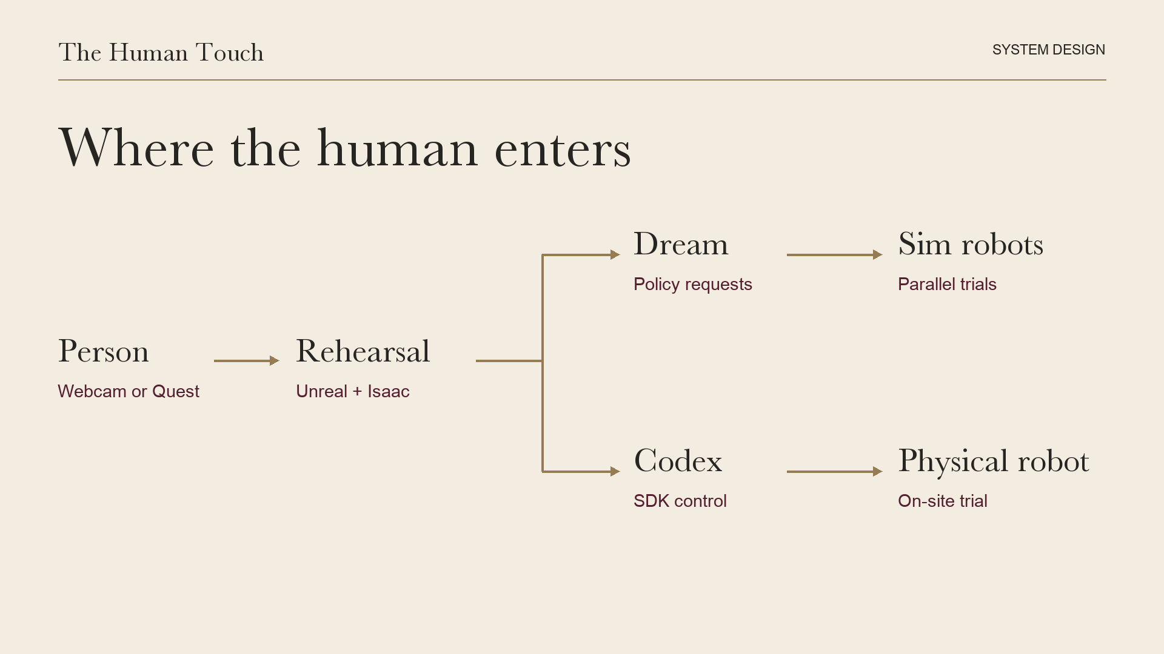
Notes:
Finals and questions only. Walk through the inputs and the split between virtual policy requests and direct physical-arm control. Isaac and Unreal show the architecture; do not imply a verified live physics stream.

Slide 16
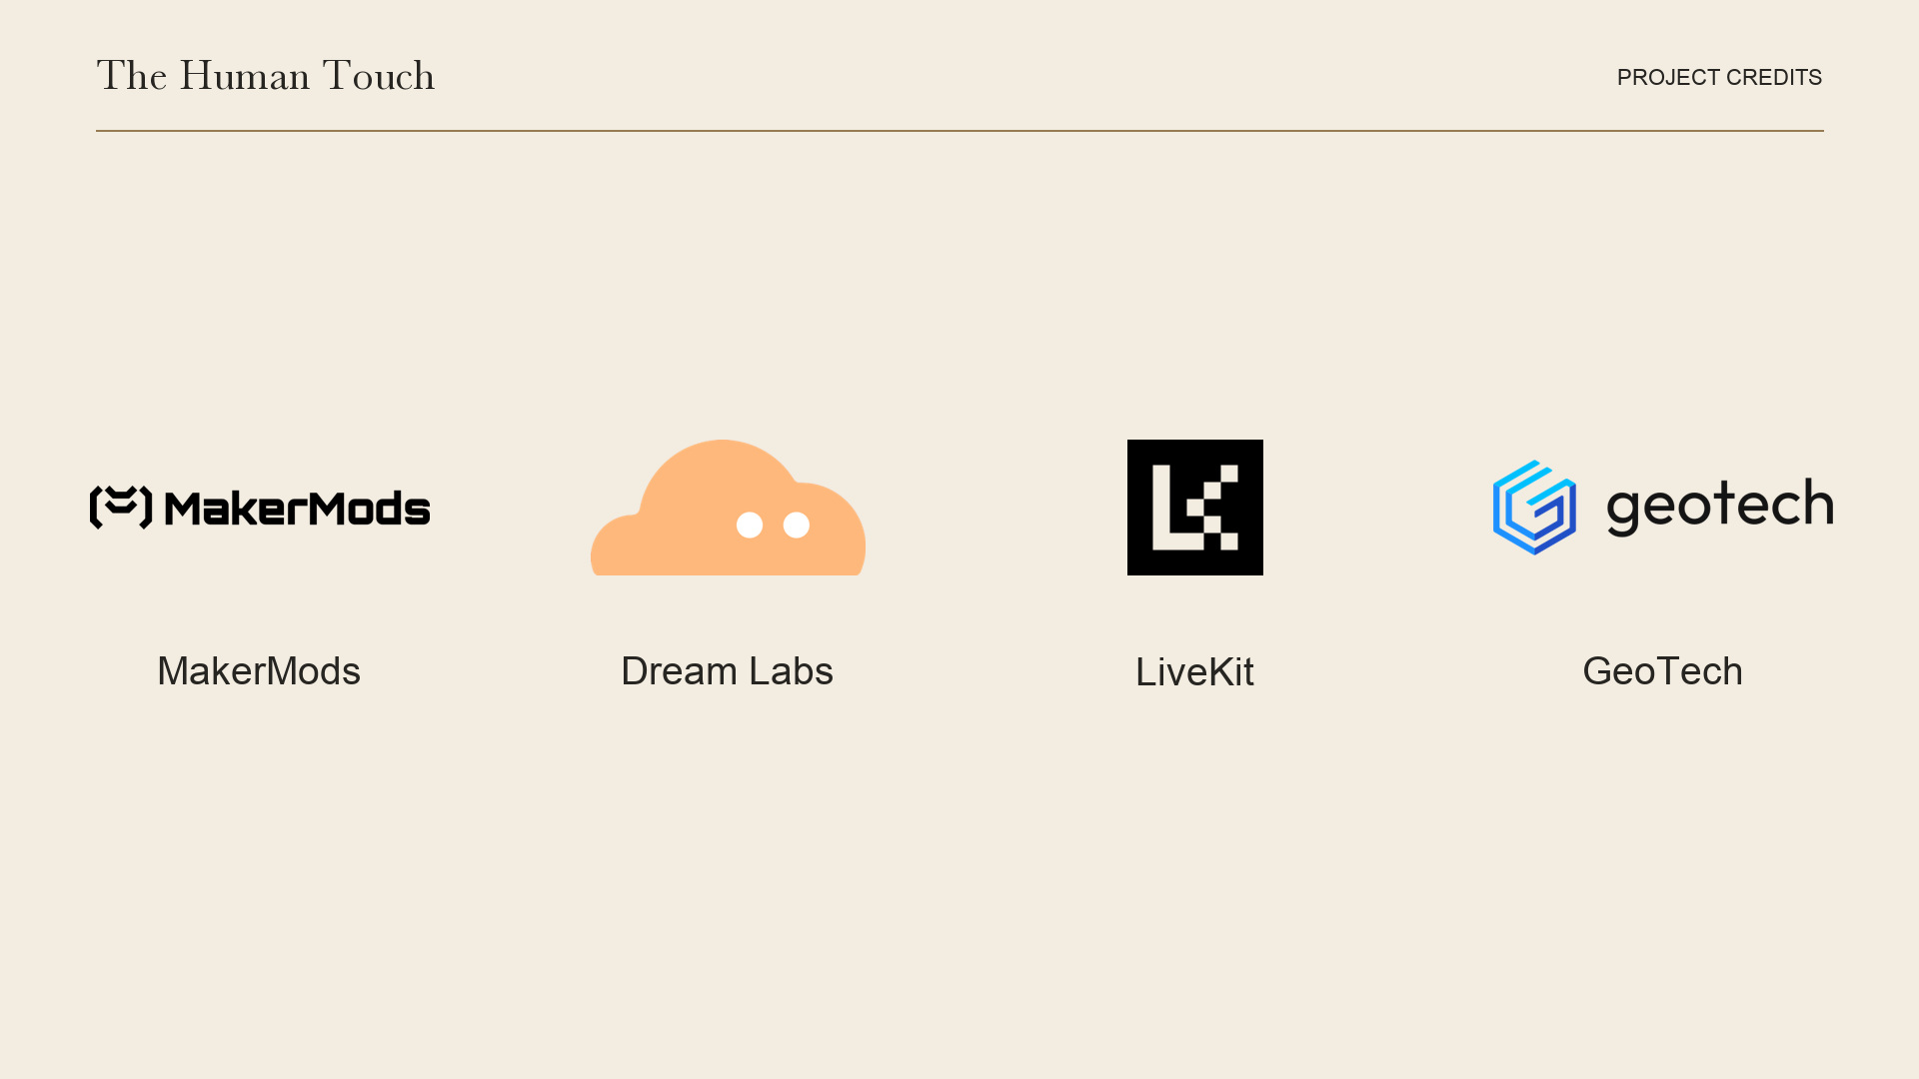
Notes:
Finals and questions only. MakerMods supplied the hardware platform, Dream Labs the Dream policy, LiveKit is the voice/streaming integration in the design, and GeoTech built the hackathon project. Confirm the team photo after feature lock.

